Slide 1


Title of Project Online pharmacy management system This project is submitted for The Major Project for College Training with Degree of BCA of Maulana Abul Kalam Azad University of Technology (Formerly WBUT) Project By- NAME: Sayan Mukherjee Registration No: 151531010009 of 2015-2016 Roll No: 15301215009 College/Institute: SYMAPRASAD INST. OF TECH. & MANAGEMENT Under the guidance of PROF. BIRABRATA GANGULY DEPARTMENT OF BCA Bachelors in Computer Application, BCA Syamaprasad Institute Of Technology and Management

Slide 2

ACKOWLEDGEMENT
The satisfaction that accompanies the successful completion of this project would be incomplete without the mention of people whose ceaseless co- operation made it possible, whose constant guidance and encouragement crown all efforts with success.
Our sincere regards to PROF. BIRABRATA GANGULY for the guidance, inspiration and constructive suggestions that helped us in the preparation of this project. We convey our sincere thanks to PROF. SHANKAR PRASAD MITRA for this commendable support towards successful completion of our project.

Slide 3
ABSTRACT
SM MEDICINE SHOP practices have evolved over time to become fully encompassed in all aspects of pharmacy itself. Such practices include: dispensing of drugs, consultation, drug regulation, and the sale of these drugs. There is a need for these practices to be fully enforced, and a management system introduced With software such as the Online Pharmacy Management System, which provides a platform has been provided to help with drug regulation, as well as providing ease to all parties involved. The methodology used in the implementation of the software is the Incremental Model of System Development Life Cycle, which allows room for scalability as time goes on. Creating an Online Pharmacy Management System would help in pharmacy practices for all parties involved. It is eminent that the system provides a safe, secure and verified platform for all parties which help to bridge the communication gap and provide legitimate drugs. Therefore, if all recommendations are strictly adhered to, there will be strict monitoring and regulation of how drugs are circulated and a decrease in the spread of fake drugs

Slide 4
I N T R O D U C T I O N
Problems in Pharmacy
• Handling Accounts & transactions (Payments, sales)
• Handling Stock(Available stock, Expire dates,)
• Bill issuing.
• Responsibilities of the employees (mistakes, cheatings).
That is why we are giving Pharmacy Management Solution
The main aim of the project is the management of the database of the pharmacy shop. This is done by creating a database of the available medicines in the shop. The database is then connected to the main program by using interconnection of the HTML,CSS,PHP program and the database already created.

Slide 5
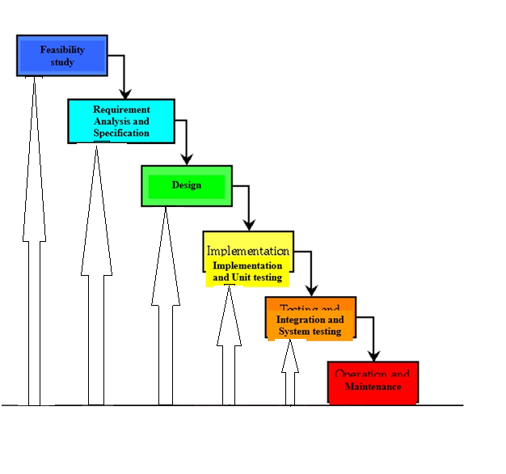
Methodology
The approach that was used in the design of the system is the Incremental Model of System Development Life Cycle where the product being designed is implemented and tested incrementally. It is relatively cheap and is used for small projects. This methodology is most suitable for the project due to the project’s future requirements which would require changes in the system.
In the project, Waterfall model is followed.
WATERFALL MODEL

Slide 6
System Requirements
The system services and goals are established by consultation with system user. They are then defined in details and serve as a system specification. System requirement are those on which the system runs.
Hardware Requirements:
Computer with either Intel i3 processor or AMD processor.
512MB DDR RAM
40GB hard disk drive
Software Requirements:
Windows 10/8/7 operating system.
Microsoft Office package.
Sublime Text
Notepad ++
WAMP SERVER
PHPMyAdmin

Slide 7
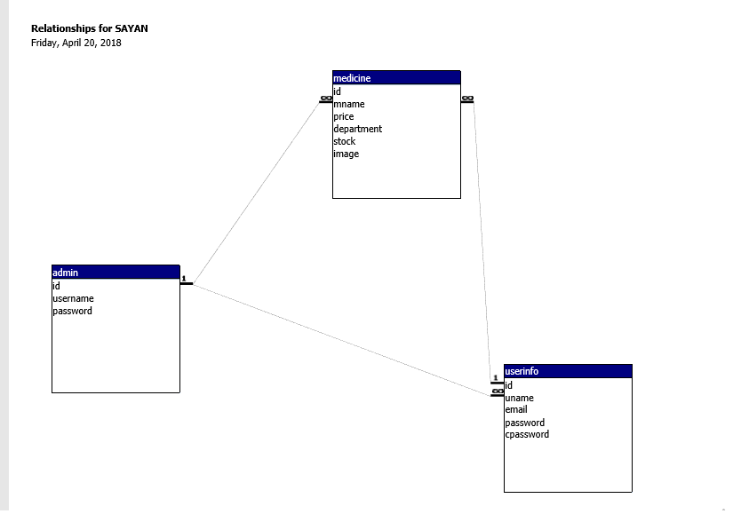
Table Structures and Uses of Tables

Slide 8
admin | `id` int(11) | `username` varchar(50) | `Password` varchar(8)
medicine | `id` int(3) | `price` Int(10) | `department` varchar(100) | `stock` int(10) | `image` text
HIMALAYA COUGH SYRUP | 1 | 50 | Cough Aids | 20 | him.jpg
ALEVED | 2 | 1247 | Cold Relief | 10 | aleved.jpg
DIGEST | 5 | 599 | Digestives & Laxatives | 4 | digest.JPG
BOROLINE | 3 | 390 | Antiseptics | 50 | boroline.jpg
DETTOLE | 4 | 106 | First Aid Kits | 15 | dettol2.jpg
DISPRINE | 6 | 40 | Pain Relief | 100 | disprine.jpg
FACE PRODUCT | 7 | 150
id | Name | Lname | Email | Password | address | Mobile | gender | dob
13 | abc | abc | abc@mail.com | abc | Abc | 1234567890 | m | 1990-01-01

Slide 9
DFD (Data Flow Diagram)
A data flow diagram (DFD) is a graphical representation of the "flow" of data through an information system, modeling its process aspects. Often they are a preliminary step used to create an overview of the system which can later be elaborated. DFDs can also be used for the visualization of data processing (structured design).
DFD
ER Modeling
In software engineering, an entity–relationship model (ER model) is a data model for describing the data or information aspects of a business domain or its process requirements, in an abstract way that lends itself to ultimately being implemented in a database such as a relational database. The main components of ER models are entities (things) and the relationships that can exist among them.
ERD

Slide 10
TESTING
White-box testing
White-box testing (also known as clear box testing, glass box testing, and transparent box testing and structural testing, by seeing the source code) tests internal structures or workings of a program, as opposed to the functionality exposed to the end-user. In white-box testing an internal perspective of the system, as well as programming skills, are used to design test cases. The tester chooses inputs to exercise paths through the code and determine the appropriate outputs. This is analogous to testing nodes in a circuit, e.g. in-circuit testing (ICT).
Black-box testing
Black-box testing treats the software as a "black box", examining functionality without any knowledge of internal implementation, without seeing the source code. The testers are only aware of what the software is supposed to do, not how it does it. Black-box testing methods include: equivalence partitioning, boundary value analysis, all-pairs testing, state transition tables, decision table testing, fuzz testing, model-based testing, use case testing, exploratory testing and specification-based testing.
Visual testing
The aim of visual testing is to provide developers with the ability to examine what was happening at the point of software failure by presenting the data in such a way that the developer can easily ﬁnd the information she or he requires, and the information is expressed clearly.

Slide 11
User interface

Slide 12
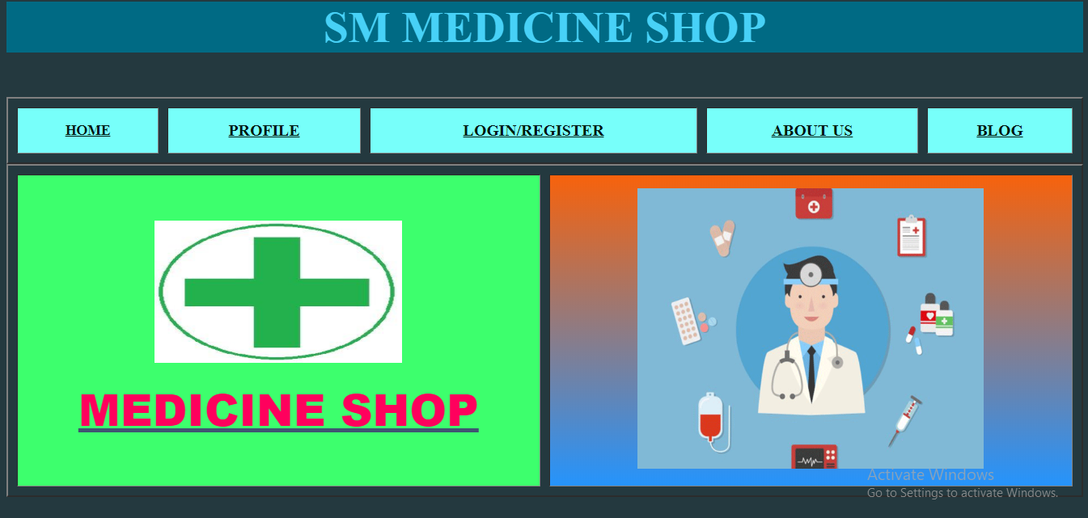
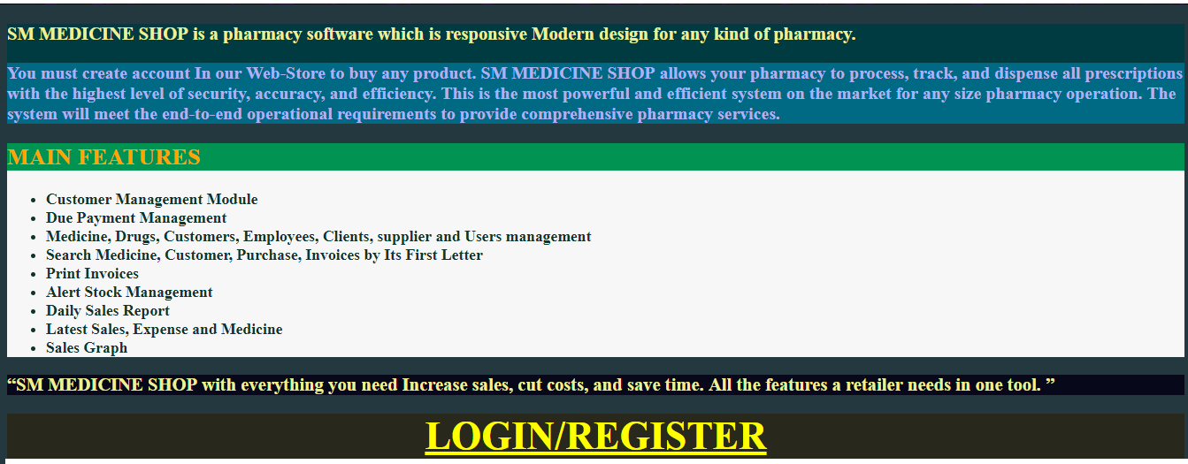
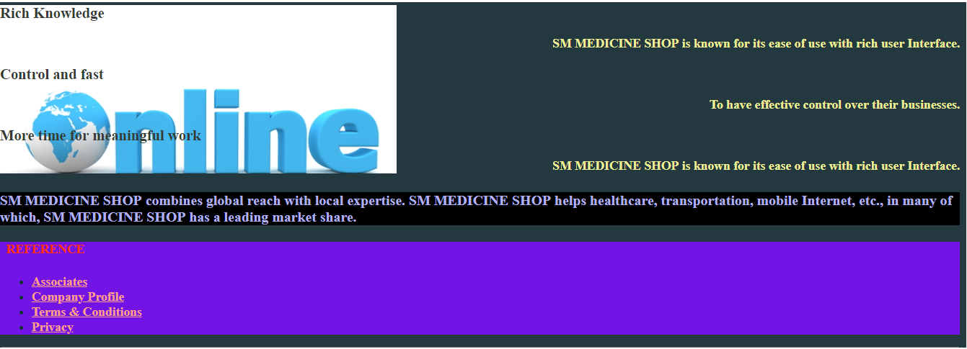
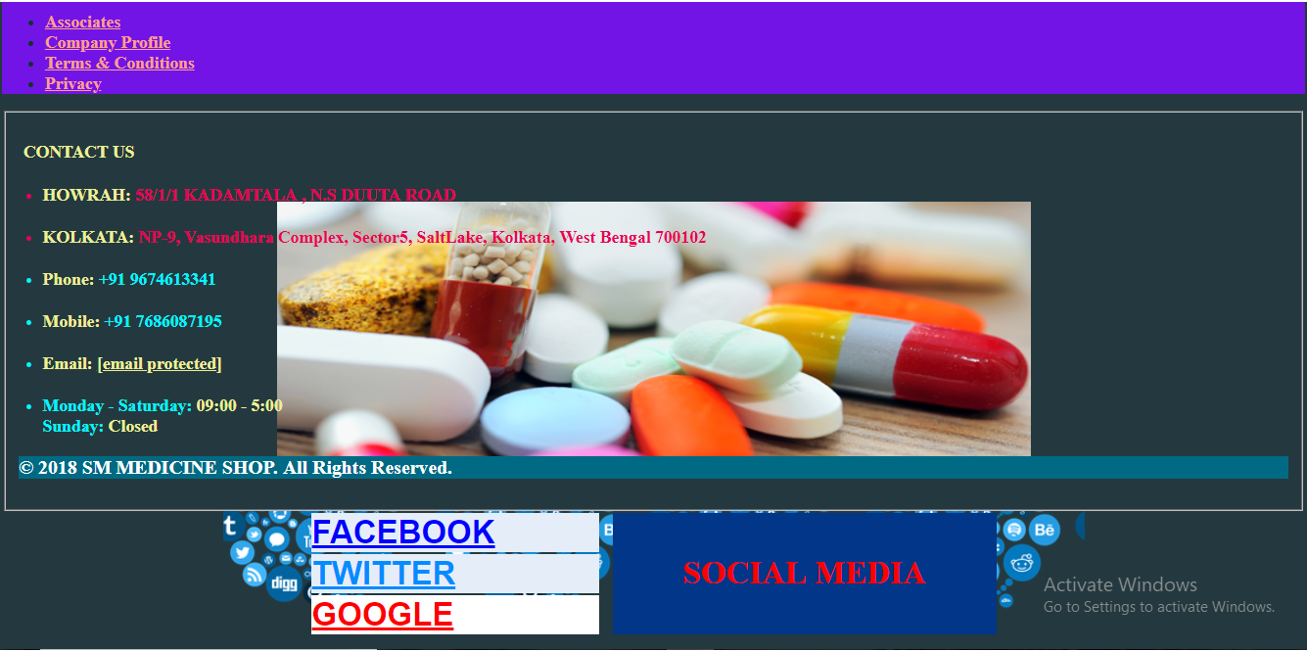

Slide 13
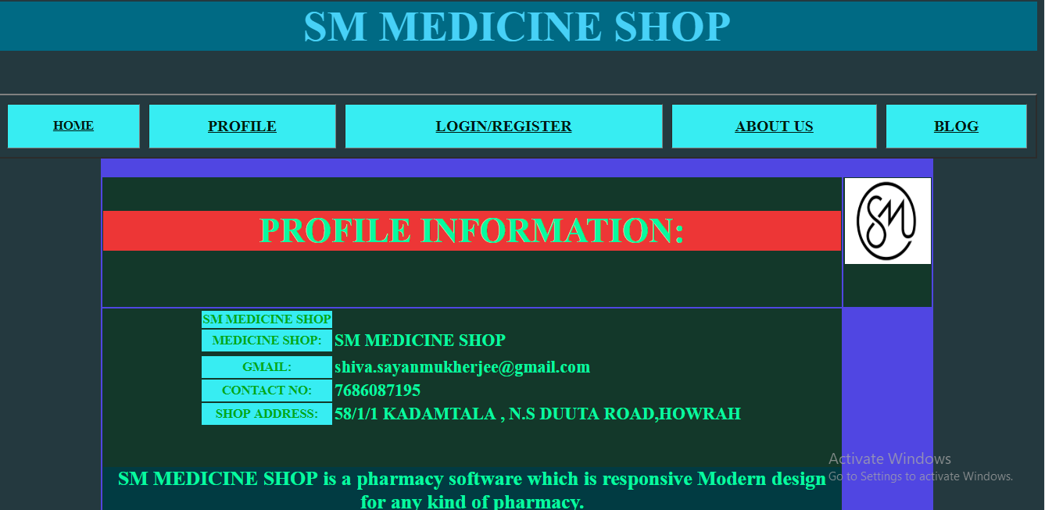
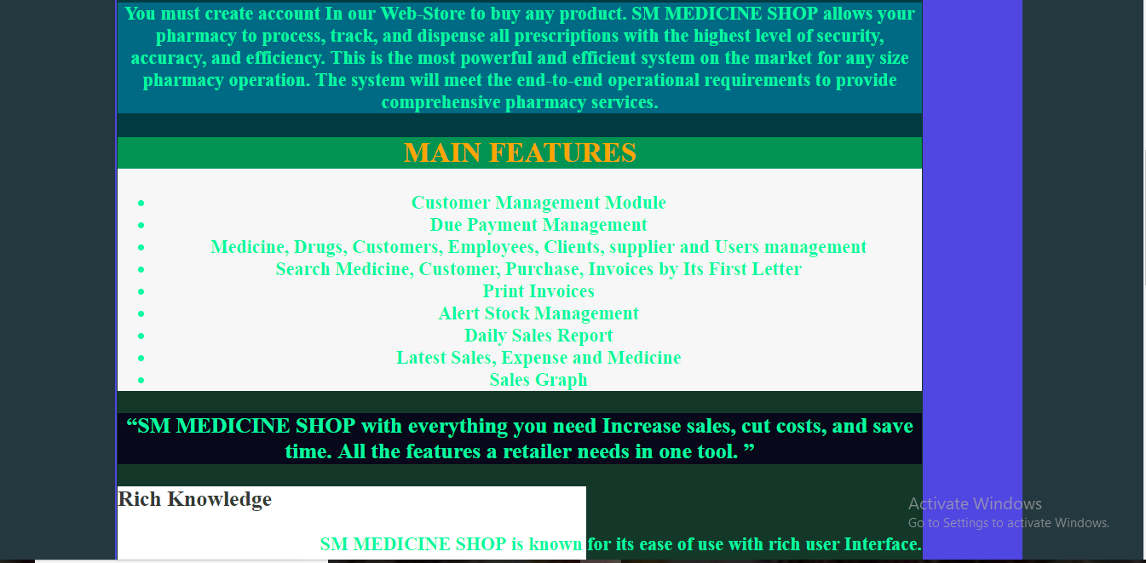
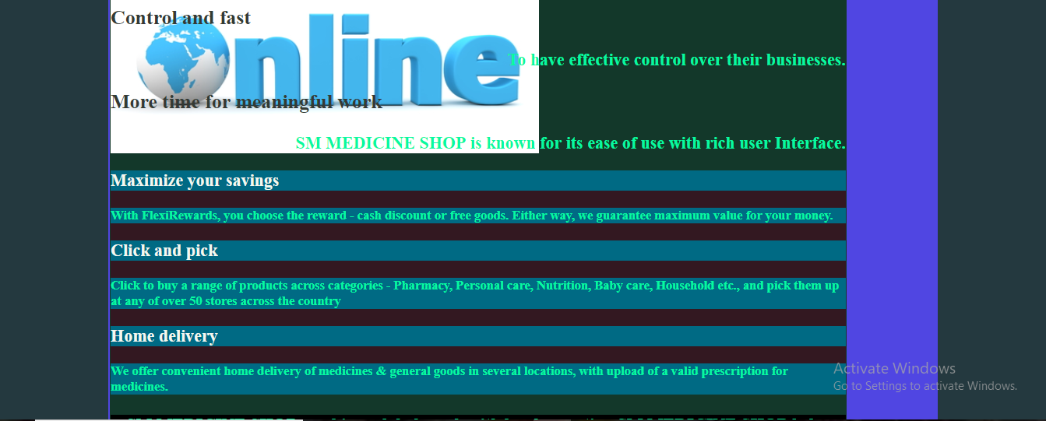
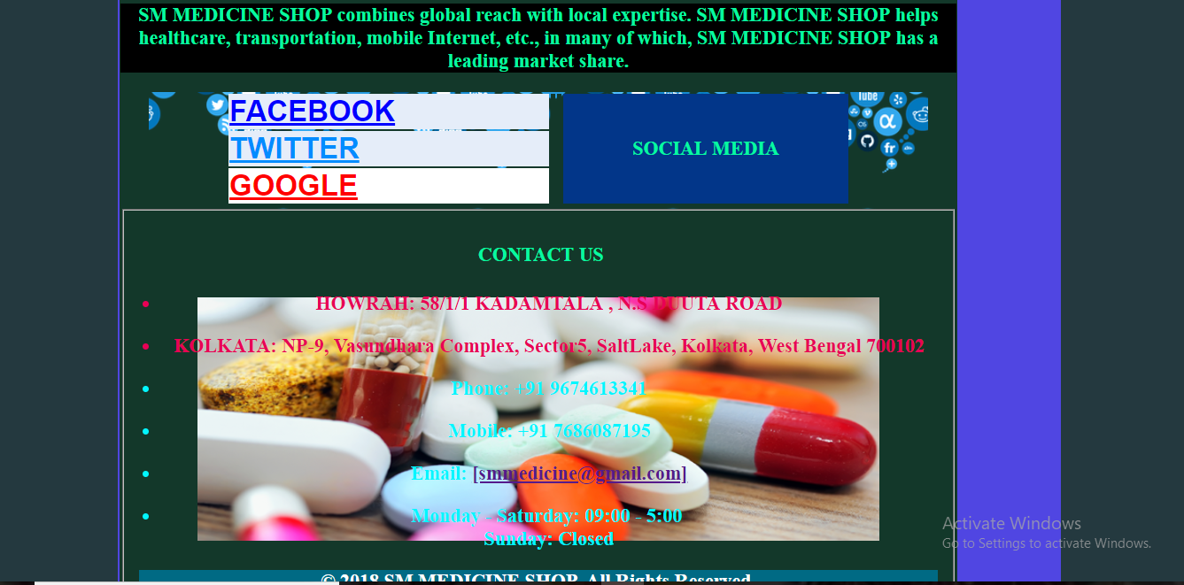

Slide 14
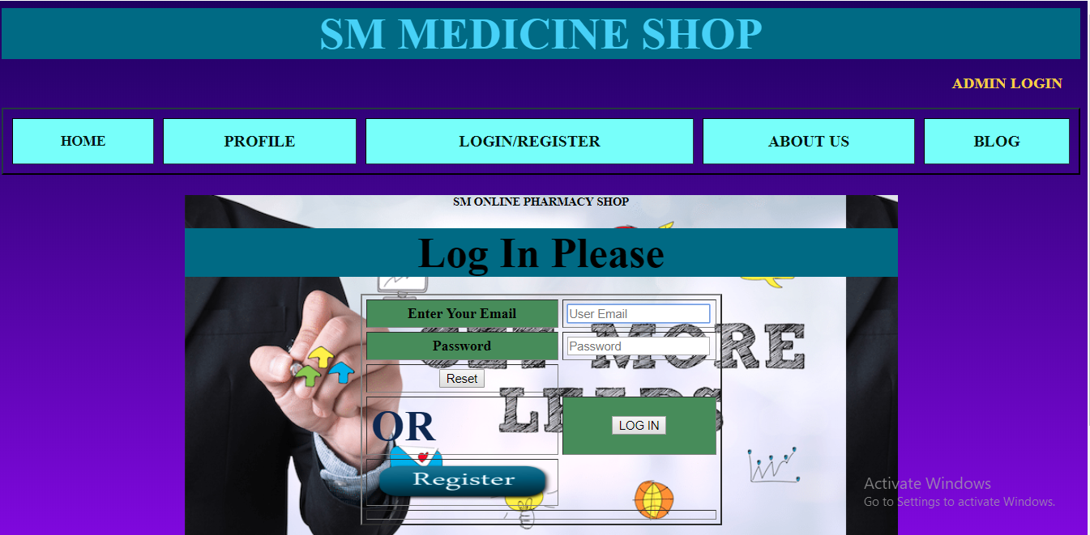
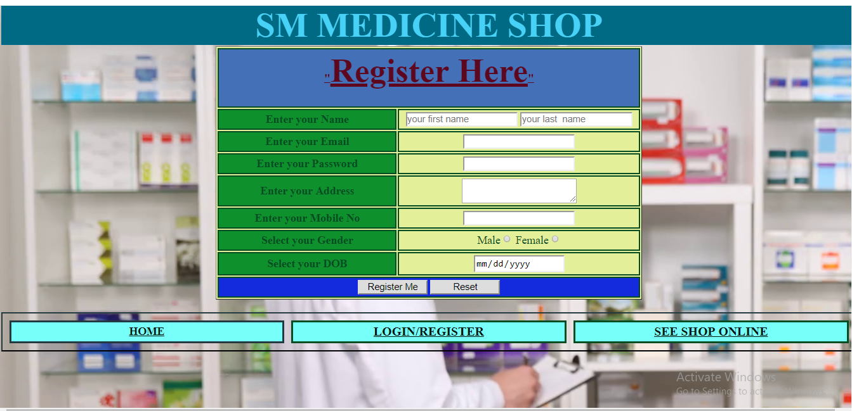

Slide 15
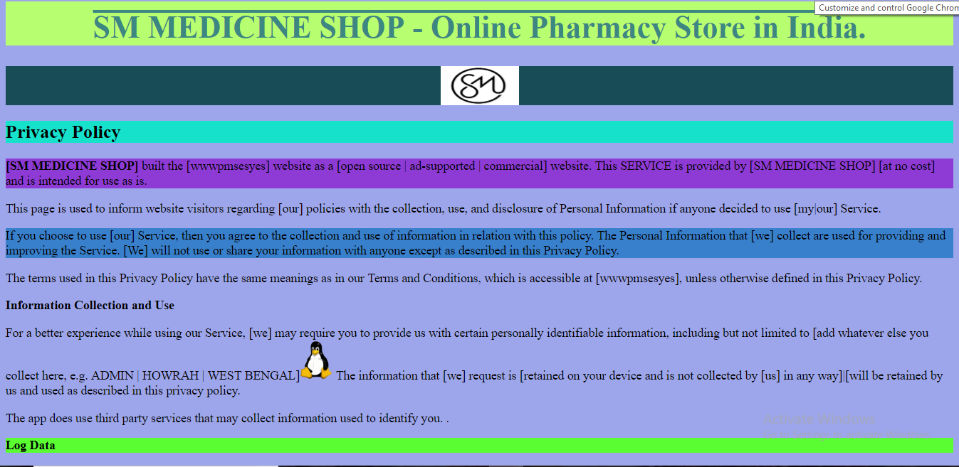
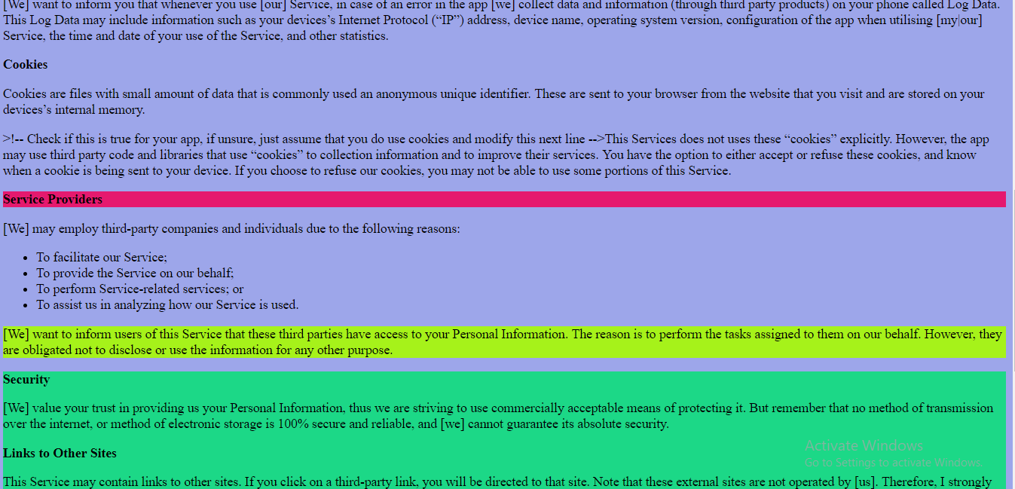
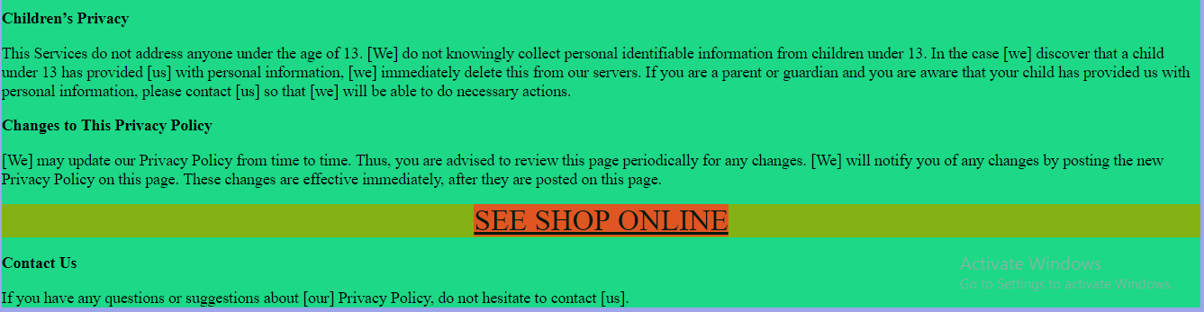

Slide 16
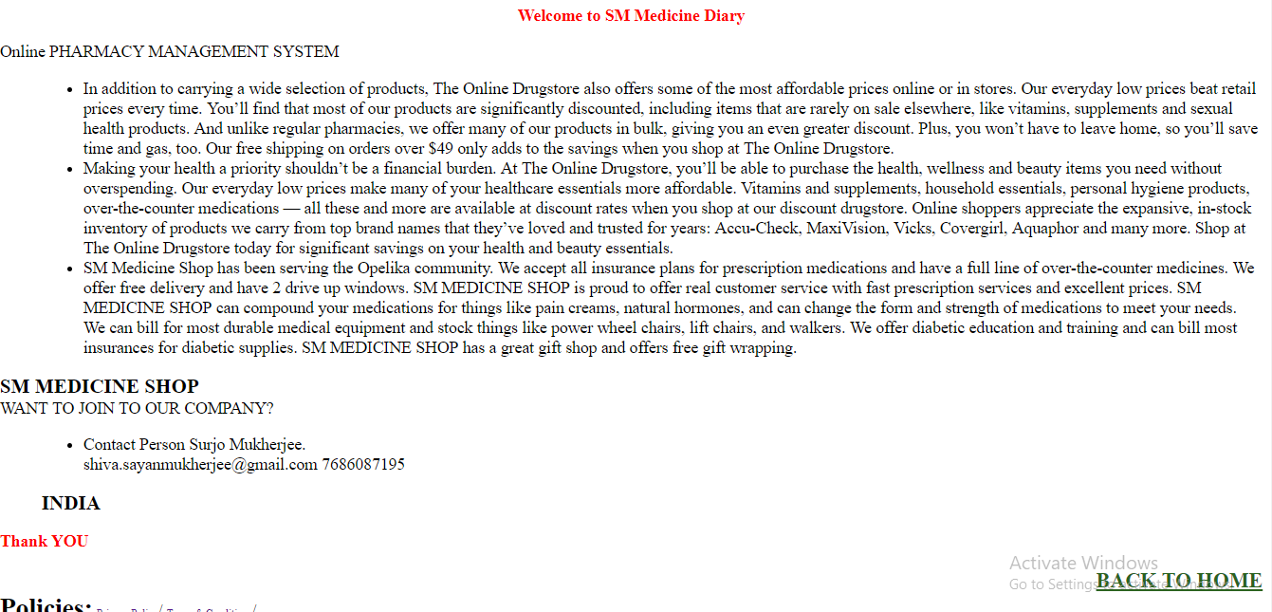
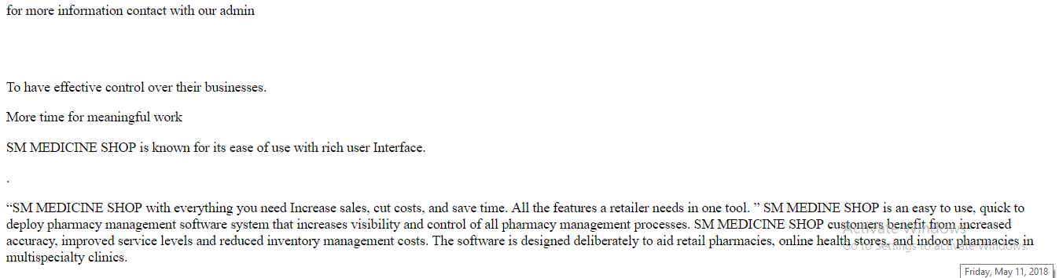

Slide 17
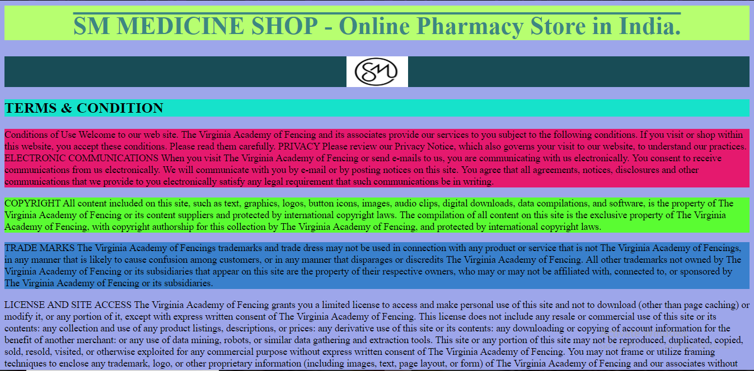
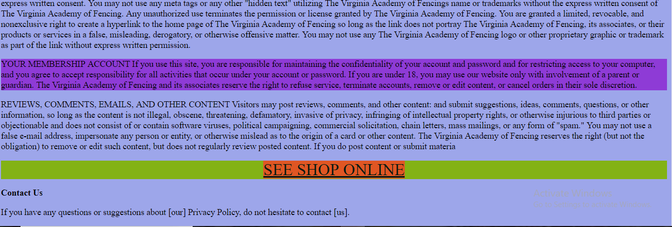

Slide 18
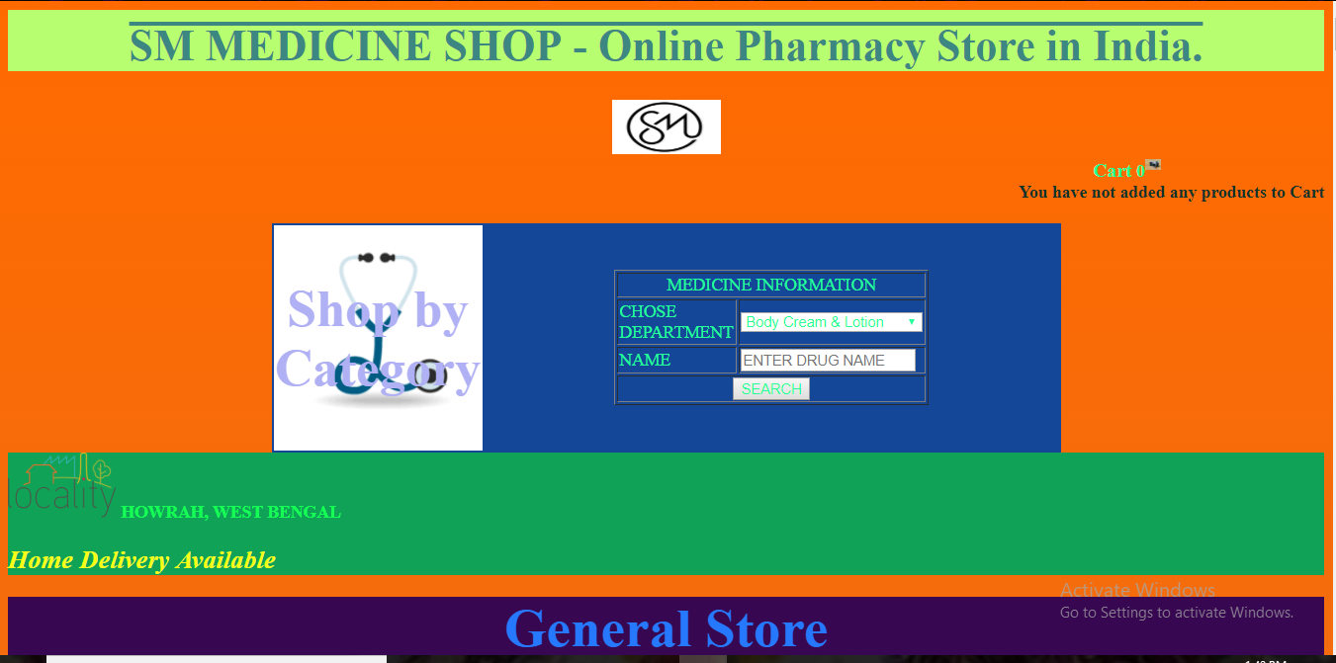
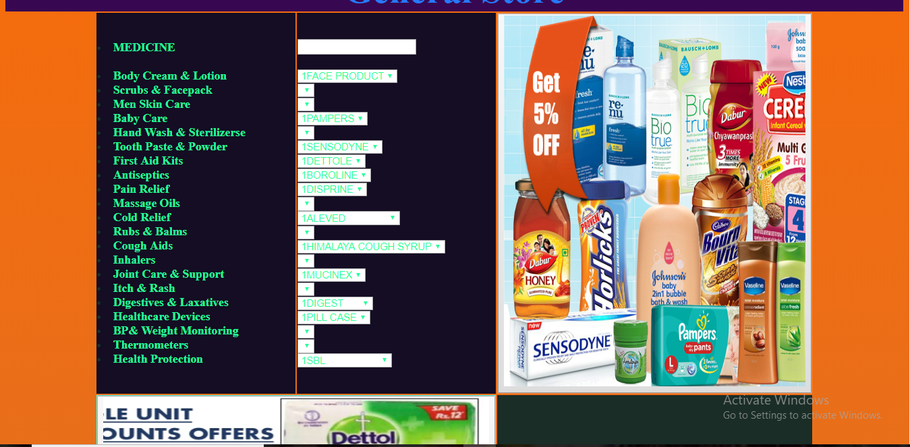
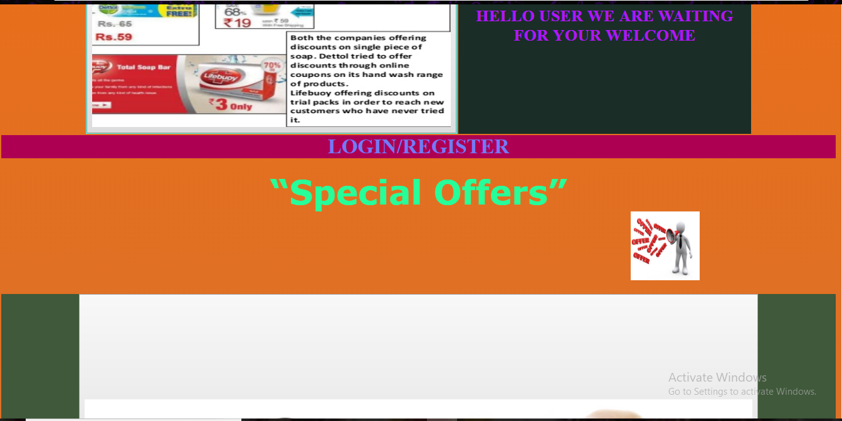

Slide 19
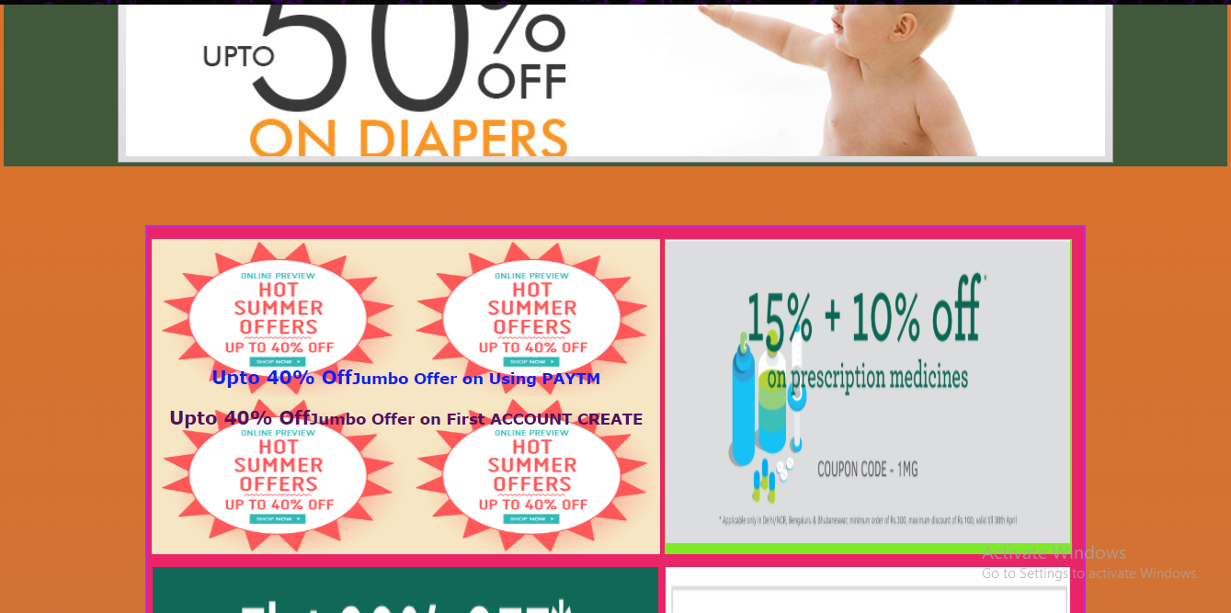
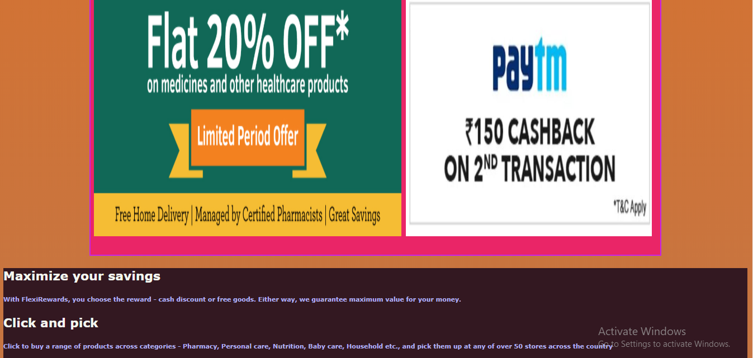
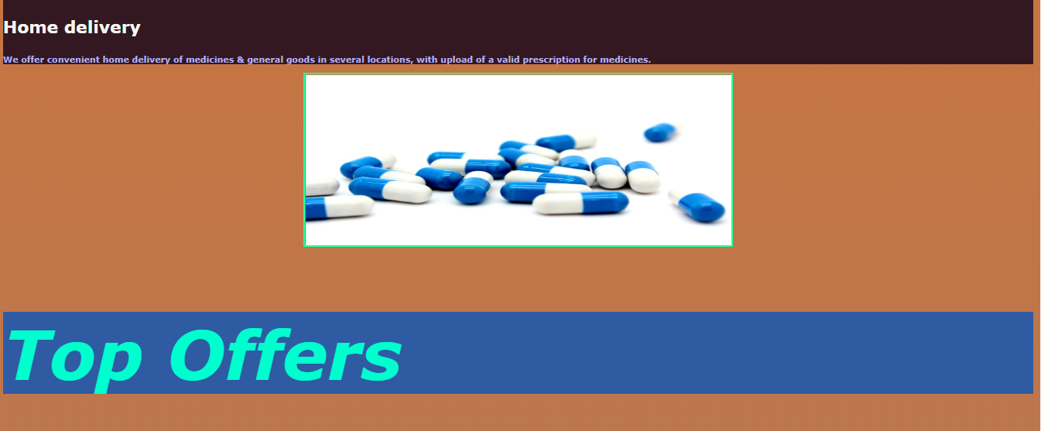

Slide 20

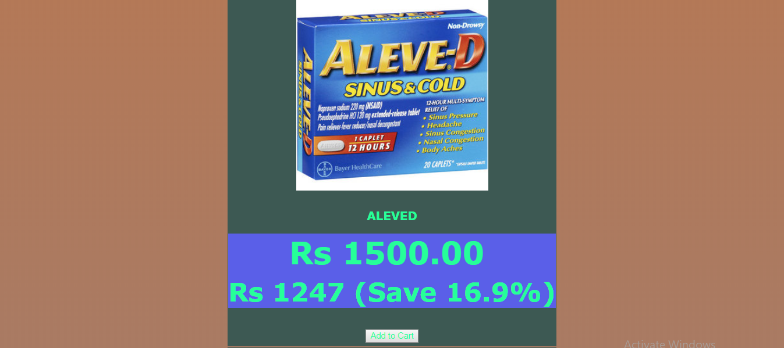


Slide 21

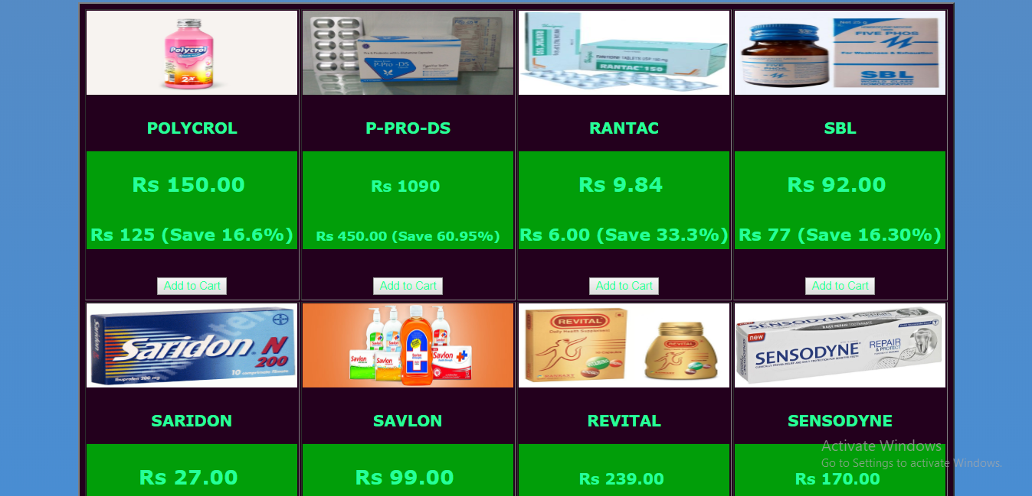
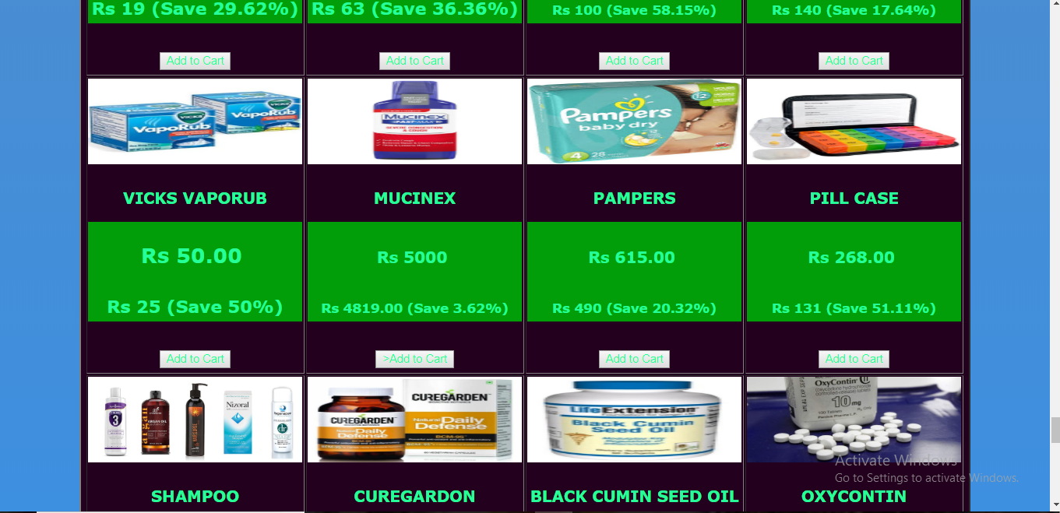

Slide 22
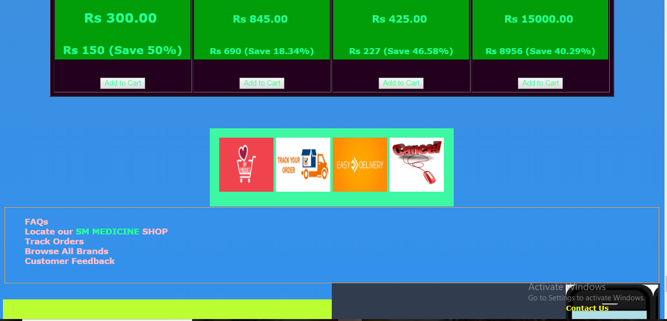
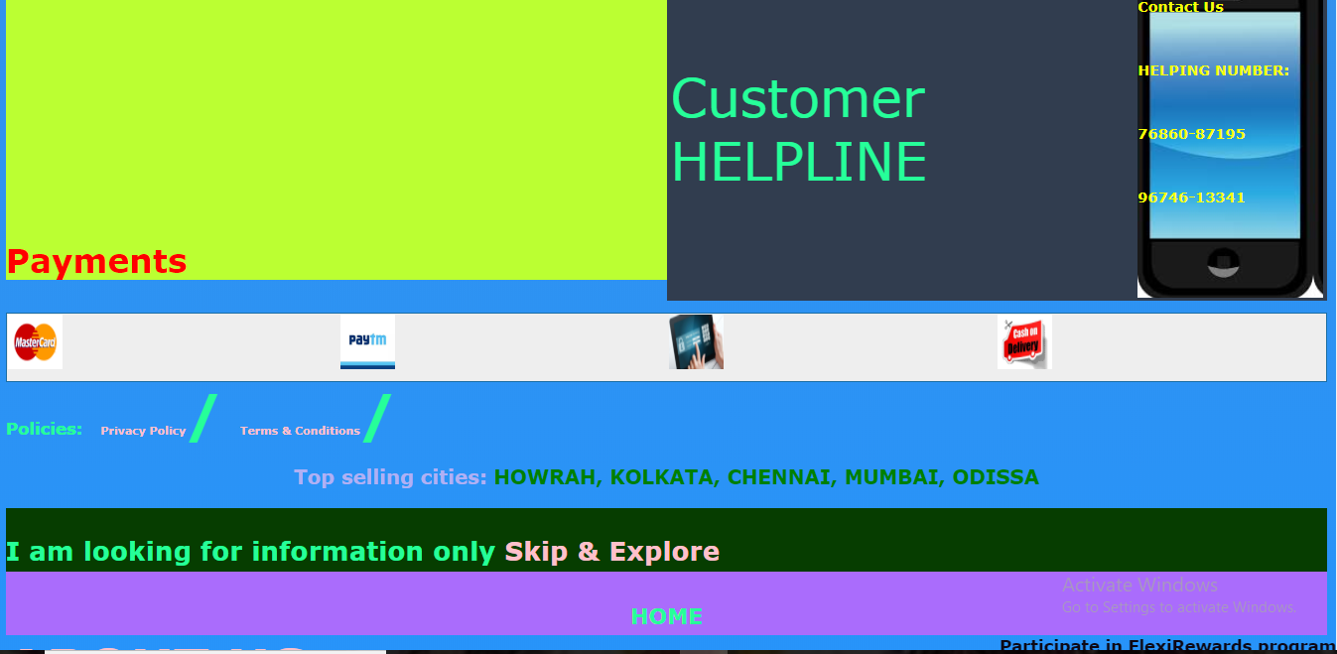

Slide 23
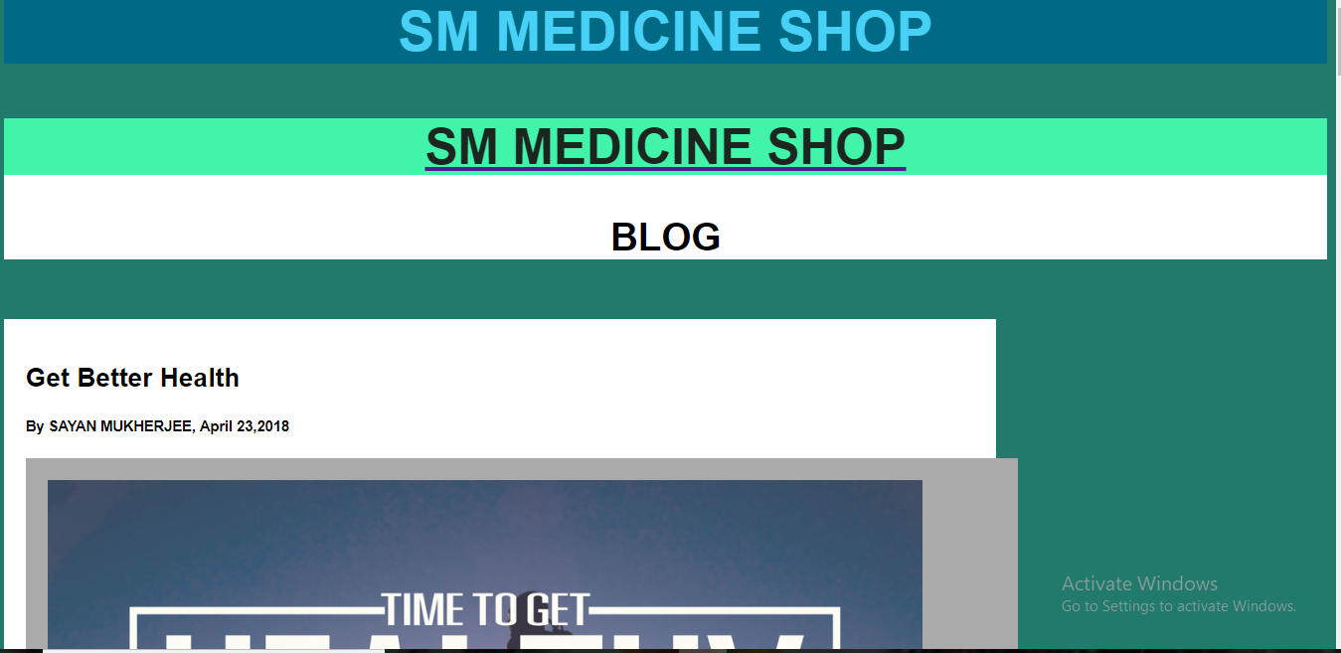

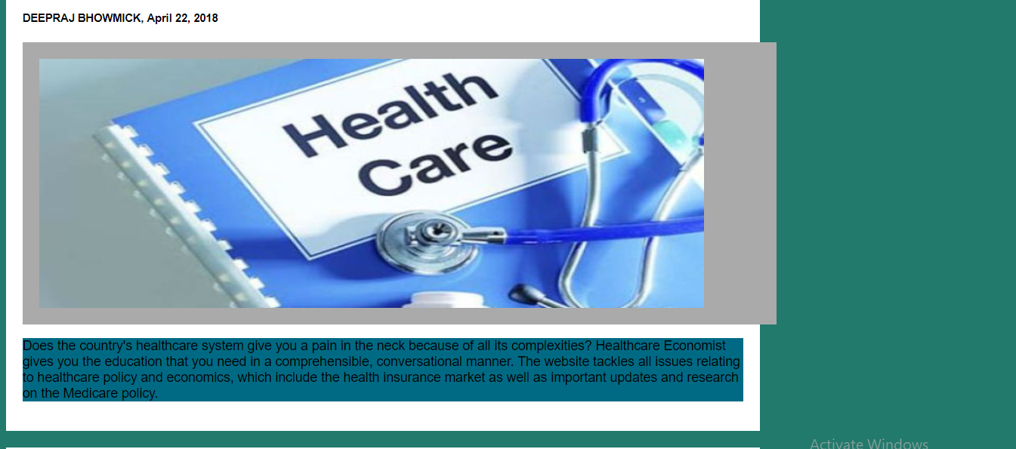

Slide 24
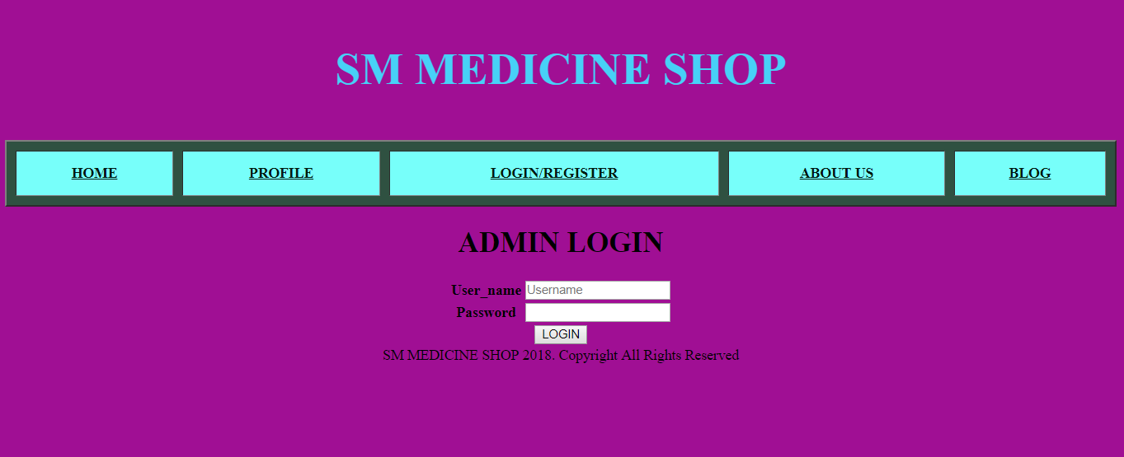
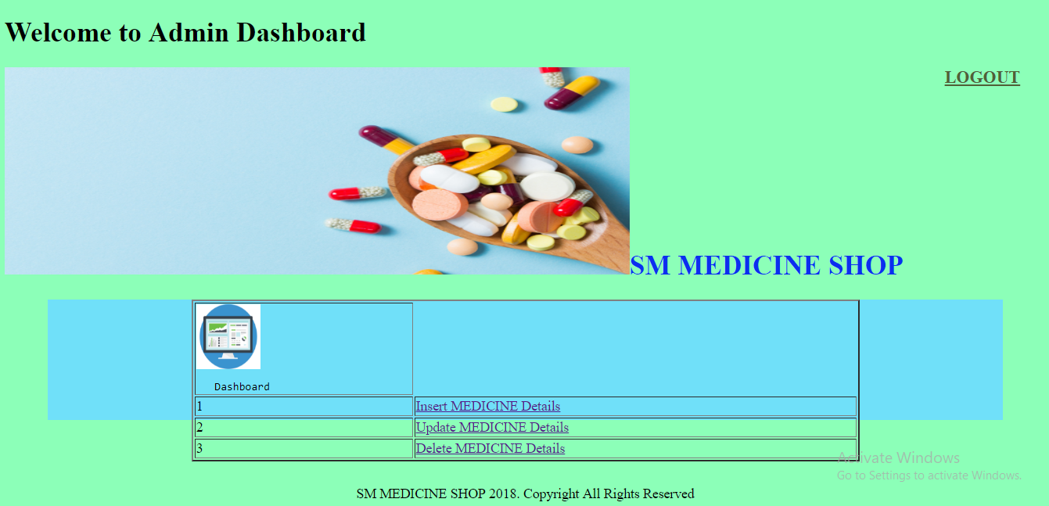

Slide 25
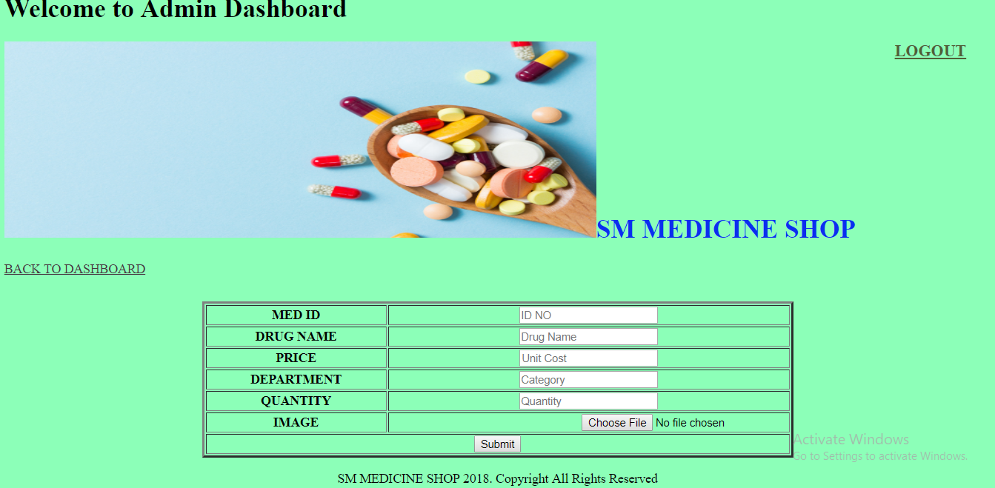
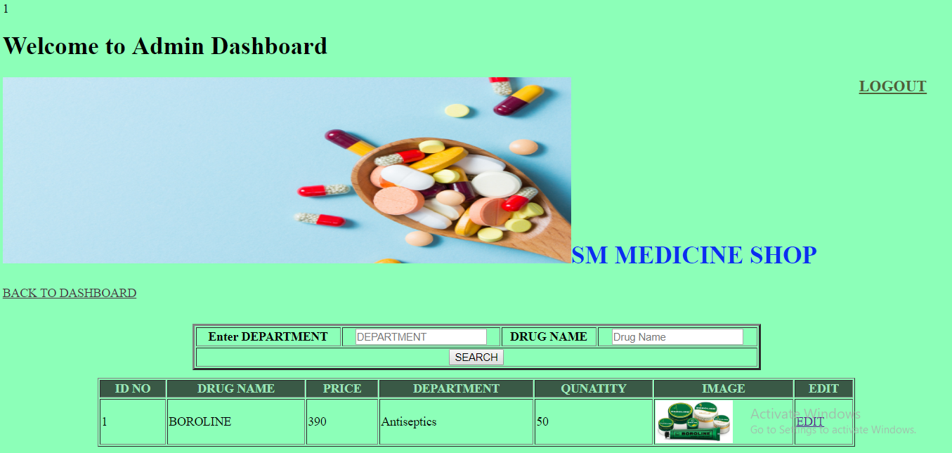
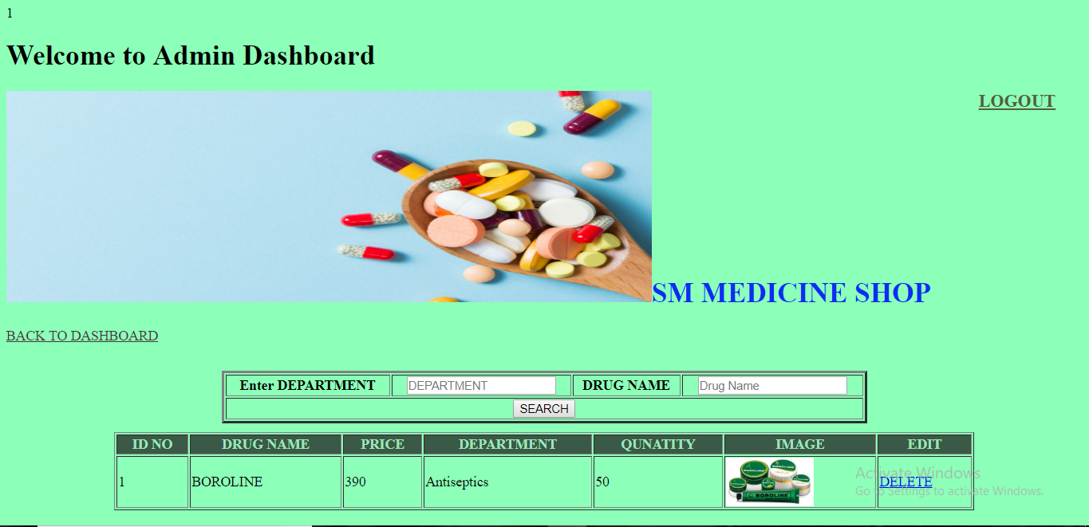

Slide 26
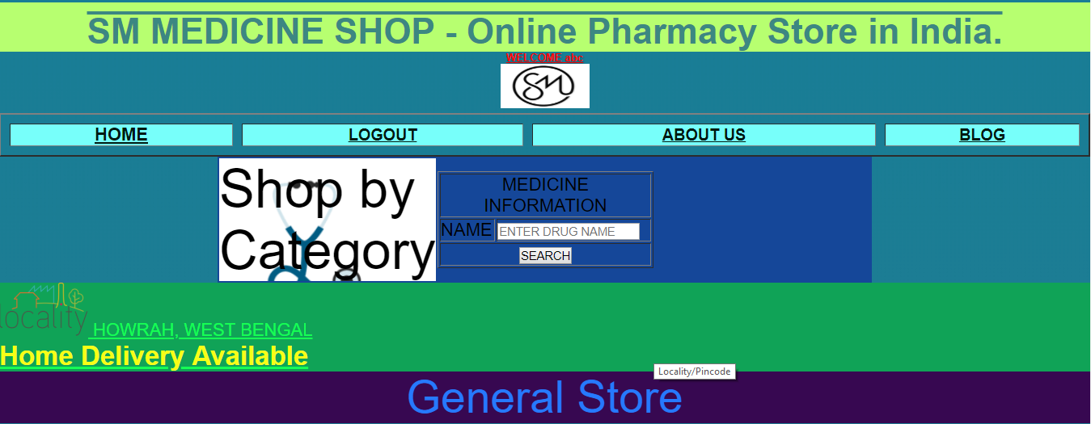
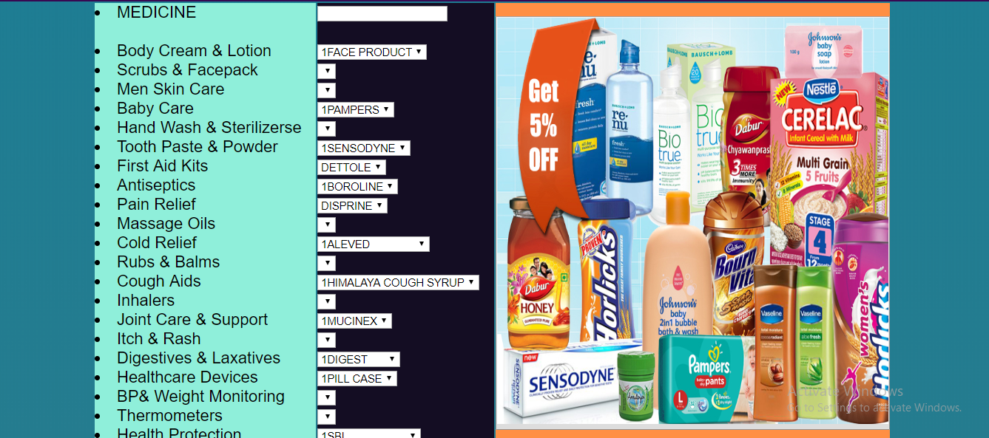
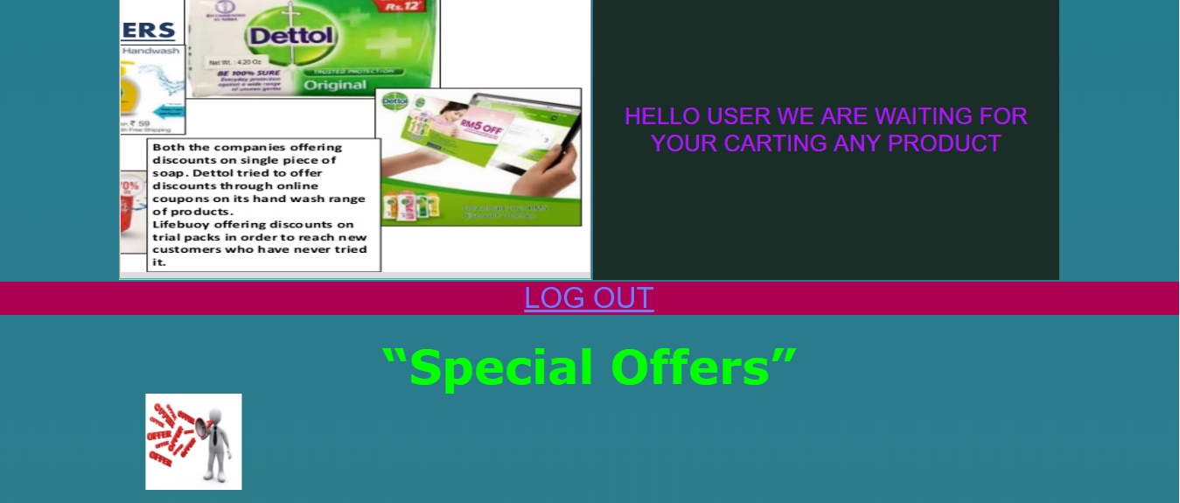

Slide 27
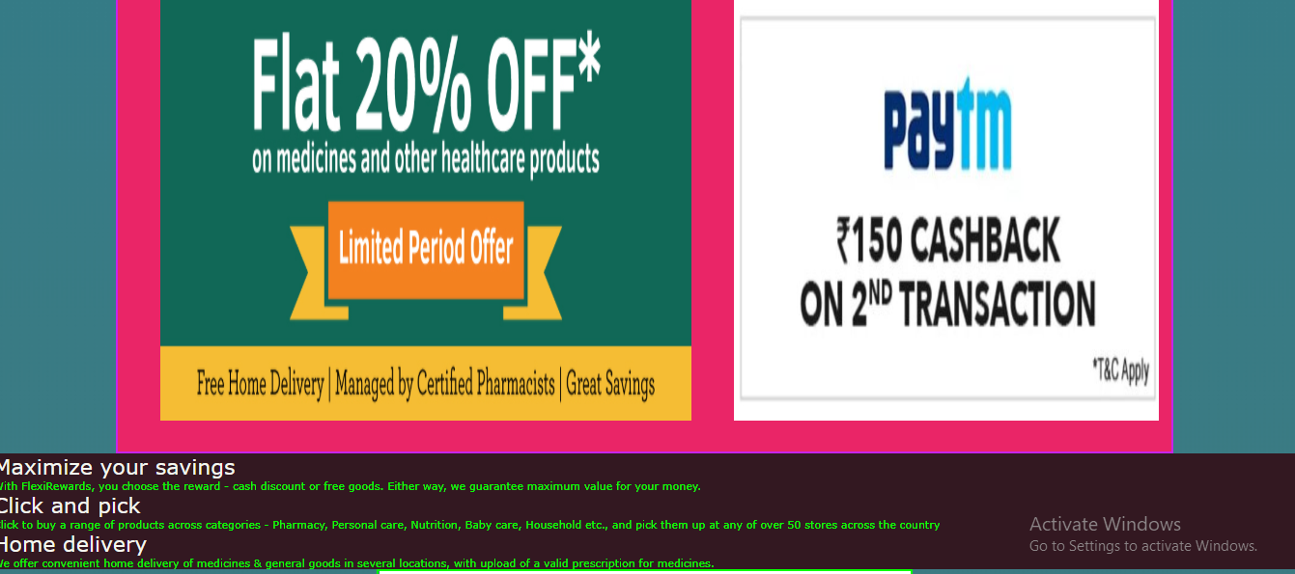
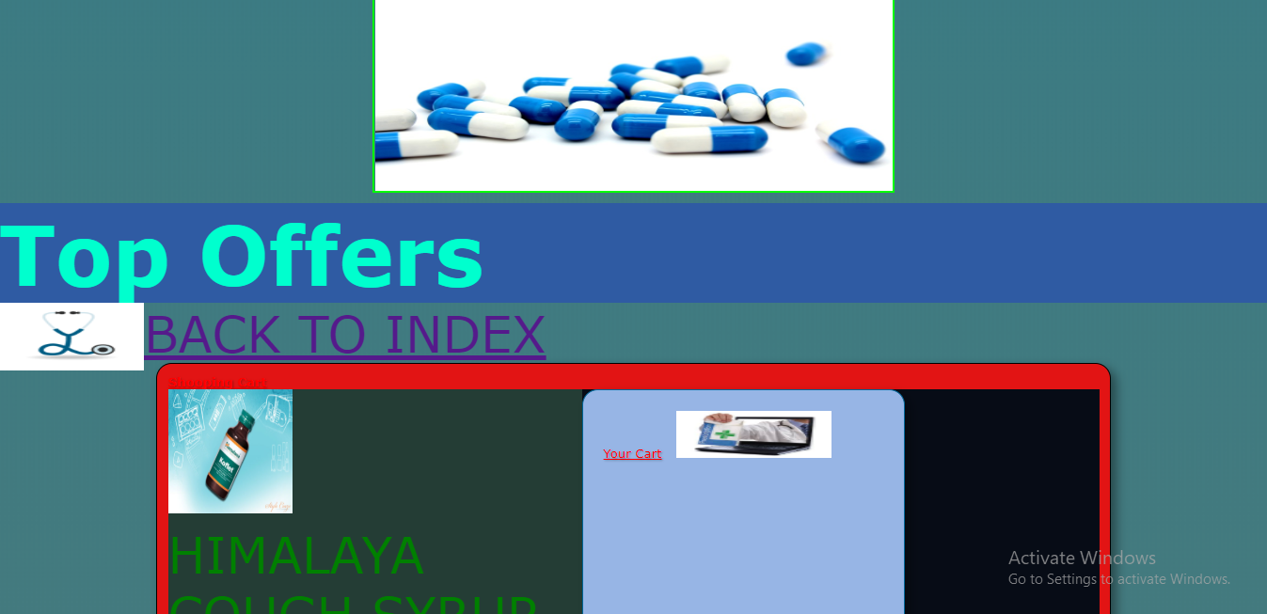
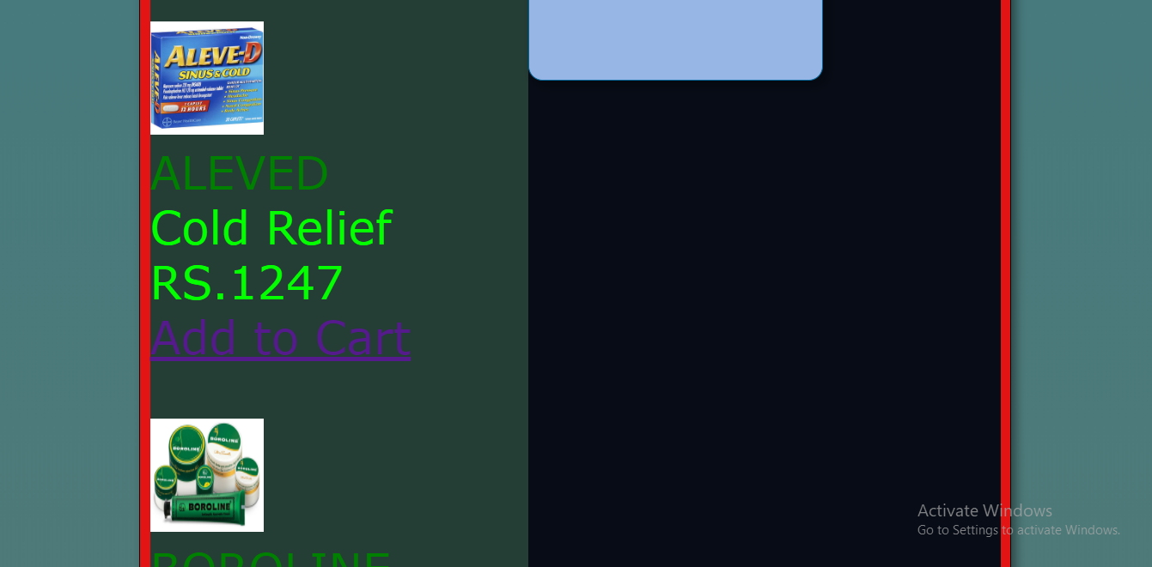

Slide 28
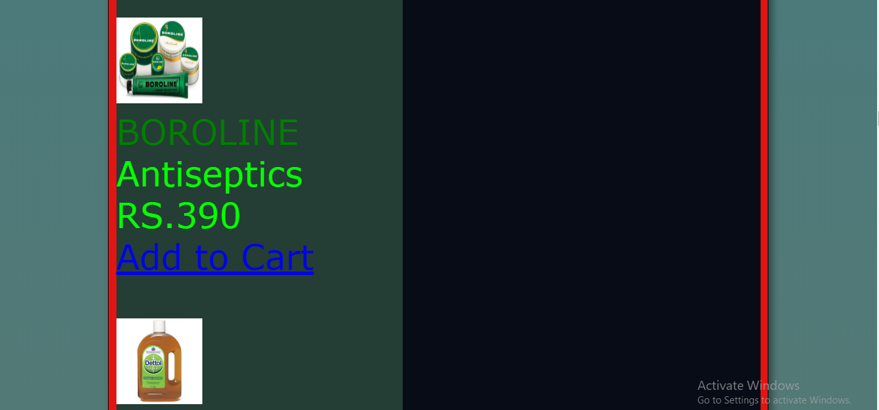
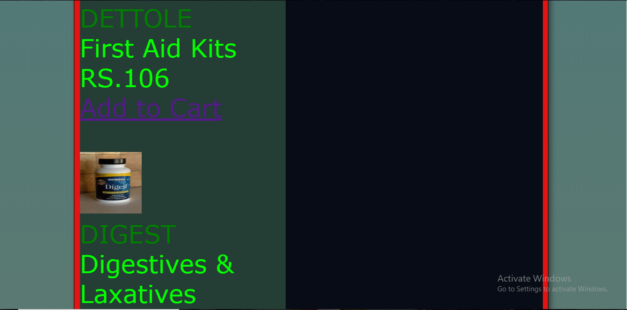
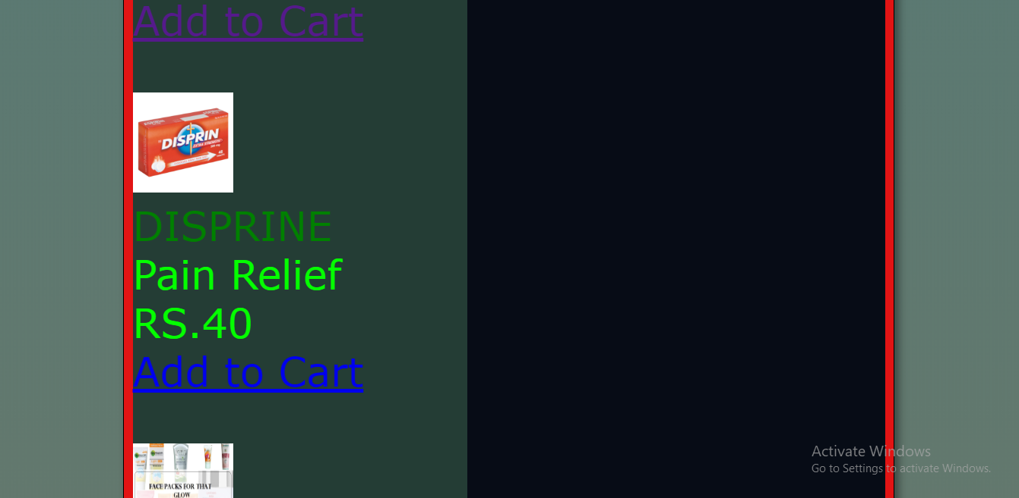

Slide 29
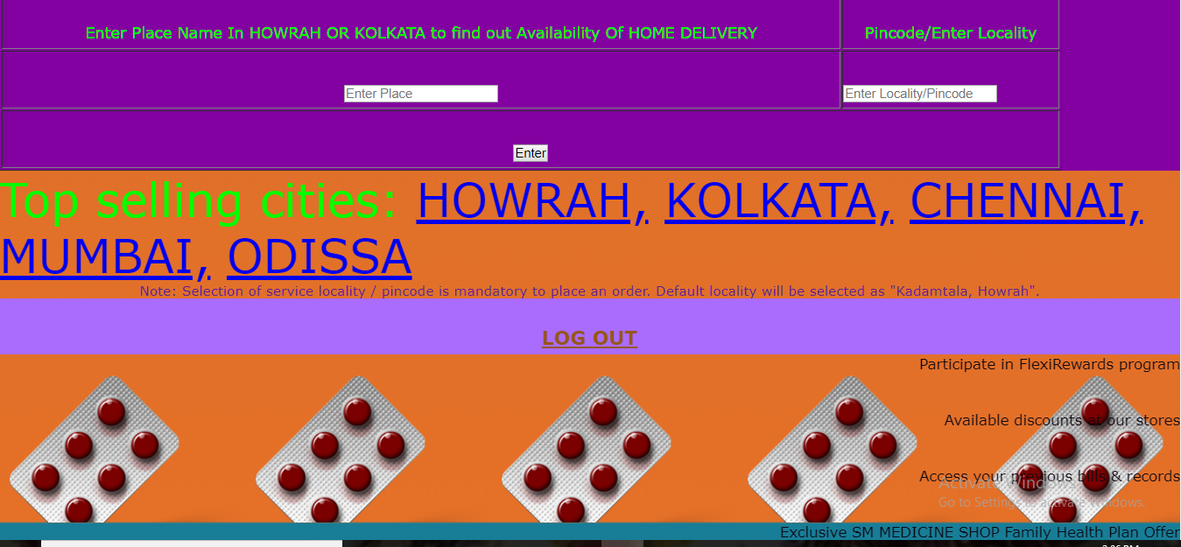

Slide 30
Conclusion
WORK DONE:
The project was successfully designed and is tested for accuracy and
quality.
During this project I have accomplished all the objectives and
this project meets the needs of the organization . The developed
will be used in searching , retrieving and generating information
for the concerned requests.
Fast finding of information requested
GOALS
Reduced entry work.
Easy retrieval of information
Reduced errors due to human intervention
Portable and flexible for further enhancement
Web enabled.

Slide 31
Bibliography
These are the following links which assist me at each and every step in completing this project, without them I was not being able to finish this importance project:
1. www.google.com
2. www.wikipedia.com
4. www.youtube.com
5. www.slideshare.net
6. www.eklavvya.in
7. www.w3schools.com
THANK YOU

